Slide 1
2
DERIVATIVES

Slide 2
2.3
Basic Differentiation Formulas

Slide 3
Basic Differentiation Formulas
If it were always necessary to compute derivatives directly from the definition, as we did in the Preceding 3.2, then
Such computations would be tedious.
The evaluation of some limits would require ingenuity.
Fortunately, several rules have been developed for finding derivatives without having to use the definition directly.
These formulas greatly simplify the task of differentiation.

Slide 4
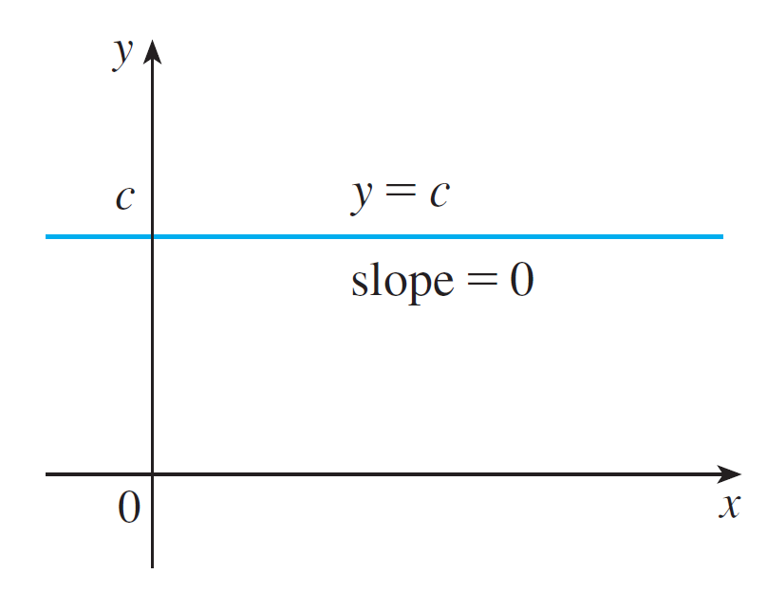
Basic Differentiation Formulas
In this section we learn how to differentiate constant functions, power functions, polynomials, and the sine and cosine functions.
Let’s start with the simplest of all functions, the constant function f (x) = c.
The graph of this function is the horizontal line y = c, which has slope 0, so we must have f ′(x) = 0. (See Figure 1.)
The graph of f(x) = c is the line y = c, so f ′(x) = 0.
Figure 1

Slide 5

Basic Differentiation Formulas
A formal proof, from the definition of a derivative, is also easy.
In Leibniz notation, we write this rule as follows.

Slide 6
Power Functions

Slide 7
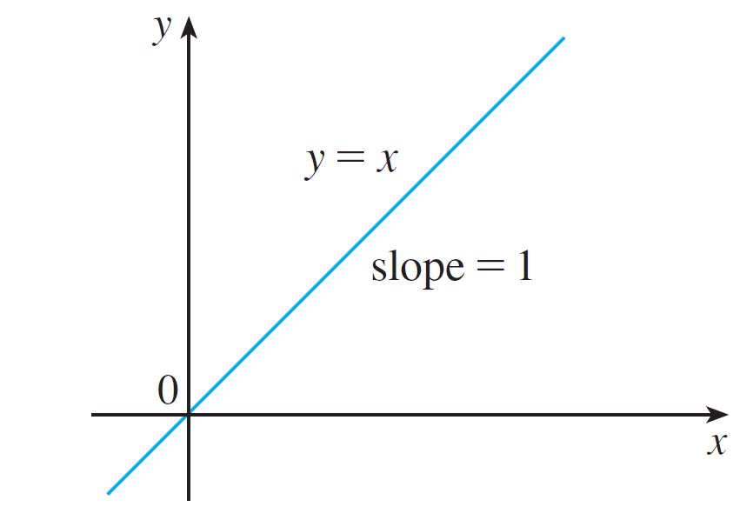
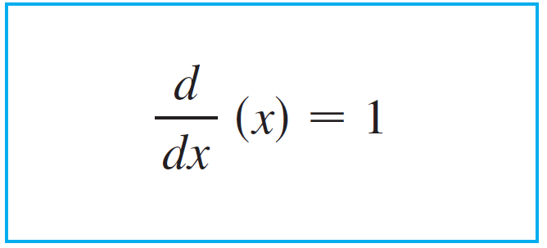

Power Functions
We next look at the functions f (x) = x^{n}, where n is a positive integer. If n = 1, the graph of f (x) = x is the line y = x, which has slope 1. See Figure 2. So,
The graph of f(x) = x is the line y = x, so f ′(x) = 1.
Figure 2

Slide 8
Power Functions
You can also verify Equation 1 from the definition of a derivative.
We have already investigated the cases n = 2 and n = 3.
In fact, in Section 2.2, we found that:

Slide 9
Power Functions
For n = 4, we find the derivative of f(x) = x⁴ as follows:
Thus,

Slide 10
Power Functions
Comparing Equations 1, 2, and 3, we see a pattern emerging.
It seems to be a reasonable guess that, when n is a positive integer, (d/dx)(x^{n}) = nx^{n –1}.
This turns out to be true.

Slide 11

Power Functions
Following is the Power Rule:

Slide 12
PROOF
If f(x) = x^{n}, then
In finding the derivative of x⁴, we had to expand (x + h)⁴.
Here, we need to expand (x + h)^{n} .
And we use the Binomial Theorem to do so.

Slide 13
PROOF
This is because every term except the first has h as a factor and therefore approaches 0.

Slide 14
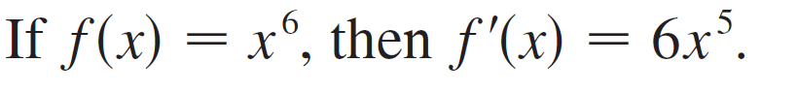
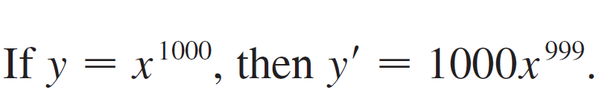
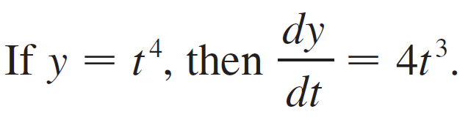
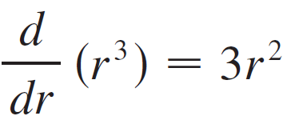
Example 1
(a)
(b)
(c)
(d)

Slide 15
Power Functions
What about power functions with negative integer exponents?
In Exercise 55 we ask you to verify from the definition of a derivative that
We can rewrite this equation as
and so the Power Rule is true when n = – 1. In fact, we will show in the next section [Exercise 55(c)] that it holds for all negative integers.

Slide 16
Power Functions
What if the exponent is a fraction?
In Example 3 in Section 2.2 we found that which can be written as
This shows that the Power Rule is true even when n = 1/2 . In fact, we will show in Section3.3 that it is true for all real numbers n.

Slide 17

Power Functions
Following is the Power Rule (General Version):

Slide 18
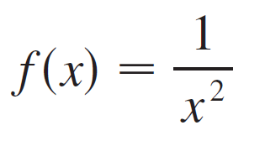
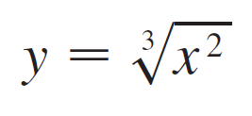
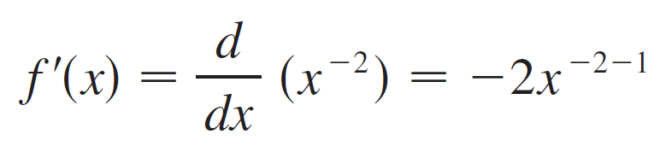
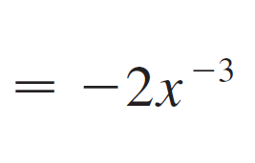
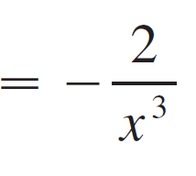
Example 2
Differentiate: (a) (b)
Solution:
In each case we rewrite the function as a power of x.
(a) Since f (x) = x^{–2}, we use the Power Rule with n = –2:

Slide 19
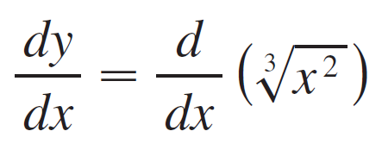
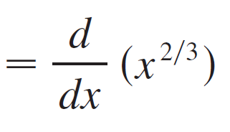
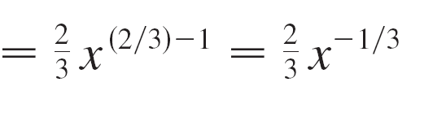
Example 2 – Solution
cont’d
(b)

Slide 20
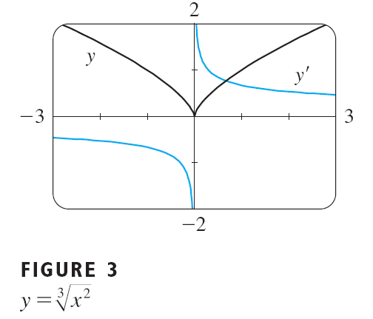
Power Functions
Figure 3 shows the function in Example 2(b) and its derivative y’.
Notice that is not differentiable at (y’is not defined there).
Observe that y’ is positive when increases and is negative when decreases.

Slide 21
Power Functions
The Power Rule enables us to find tangent lines without having to resort to the definition of a derivative.
It also enables us to find normal lines.
The normal line to a curve C at a point P is the line through P that is perpendicular to the tangent line at P.

Slide 22
Example 3
Find equations of the tangent line and normal line to the curve at the point (1, 1). Illustrate by graphing the curve and these lines.
SOLUTION
The derivative of is

Slide 23
Example 3 SOLUTION
So the slope of the tangent line at (1, 1) is .
Therefore, an equation of the tangent line is
The normal line is perpendicular to the tangent line, so its slope is the negative reciprocal of 3/2, that is, – 2/3. Thus an equation of the normal line is

Slide 24
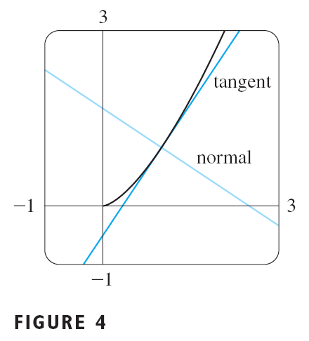
Example 3 SOLUTION
We graph the curve and its tangent line and normal line in Figure 4.

Slide 25
New Derivatives from Old

Slide 26
New Derivatives from Old
When new functions are formed from old functions by addition, subtraction, or multiplication by a constant, their derivatives can be calculated in terms of derivatives of the old functions.
In particular, the following formula says that the derivative of a constant times a function is the constant times the derivative of the function.

Slide 27
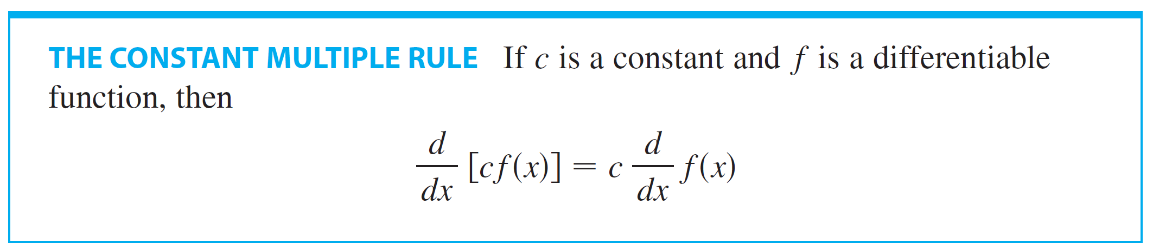
THE CONSTANT MULTIPLE RULE

Slide 28
THE CONSTANT MULTIPLE RULE
Let g(x) = cf(x).
Then,

Slide 29
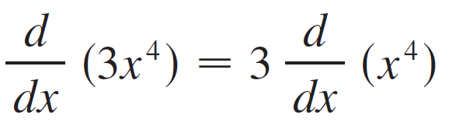

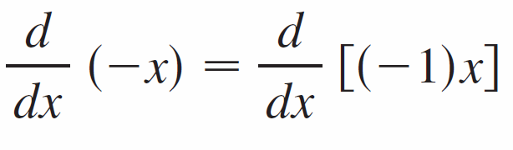
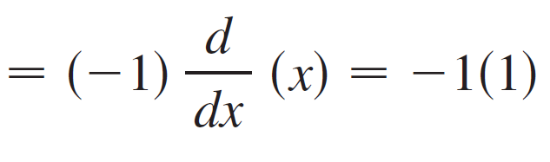
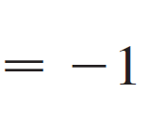
Example 4
(a)
(b)

Slide 30

New Derivatives from Old
The next rule tells us that the derivative of a sum of functions is the sum of the derivatives.

Slide 31
THE SUM RULE PROOF
Let F(x) = f(x) + g(x). Then,

Slide 32
THE SUM RULE
The Sum Rule can be extended to the sum of any number of functions.
For instance, using this theorem twice, we get

Slide 33

New Derivatives from Old
By writing f – g as f + (–1)g and applying the Sum Rule and the Constant Multiple Rule, we get the following formula.
The Constant Multiple Rule, the Sum Rule, and the Difference Rule can be combined with the Power Rule to differentiate any polynomial, as the following examples demonstrate.

Slide 34
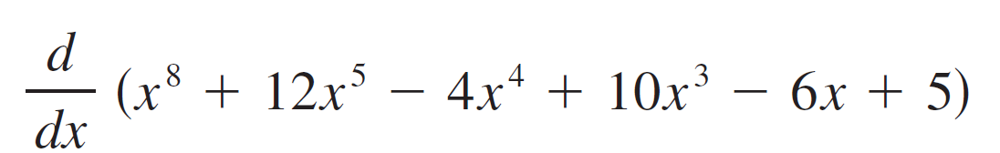
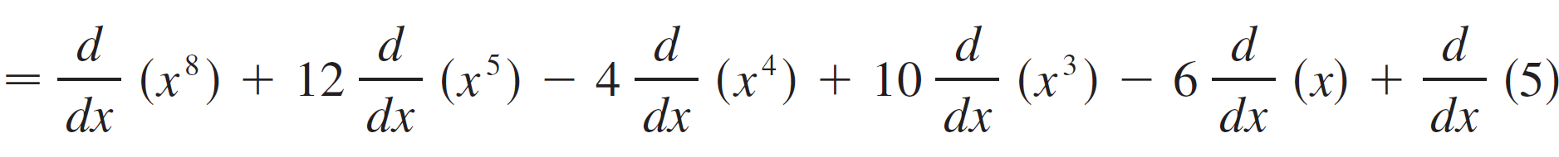
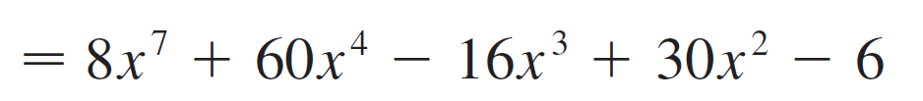
Example 5

Slide 35
Example 6
Find the points on the curve y = x⁴ – 6x² + 4 where the tangent line is horizontal.
SOLUTION
Horizontal tangents occur where the derivative is zero. We have
Thus, dy/dx = 0 if x = 0 or x² – 3 = 0, that is, x = ± .

Slide 36
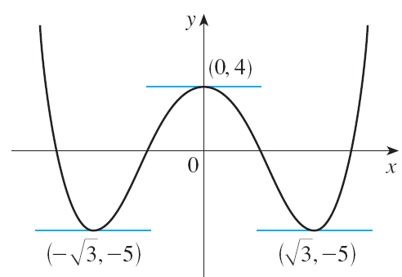
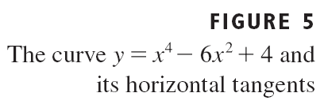
Example 6 SOLUTION
So, the given curve has horizontal tangents when x = 0, , and .
The corresponding points are (0, 4), ( , – 5), and ( , – 5).
See Figure 5.

Slide 37
The Sine and Cosine Functions

Slide 38
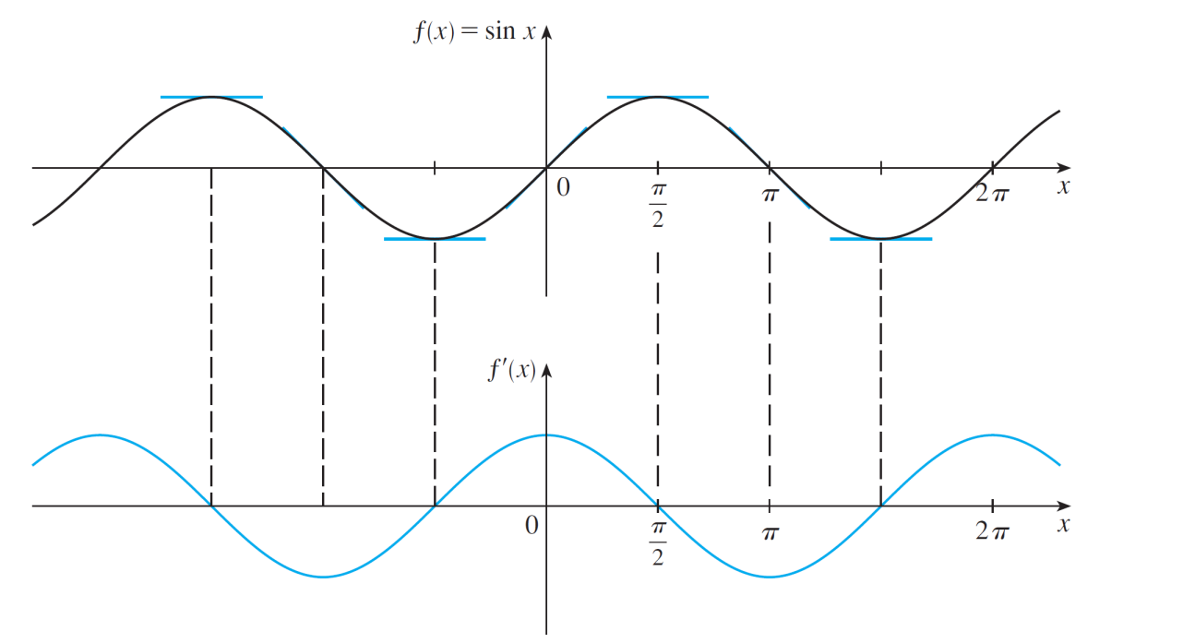
The Sine and Cosine Functions
If we sketch the graph of the function f (x) = sin x and use the interpretation of f ′(x) as the slope of the tangent to the sine curve in order to sketch the graph of f ′, then it looks as if the graph of f ′ may be the same as the cosine curve (see Figure 6).
Figure 6

Slide 39
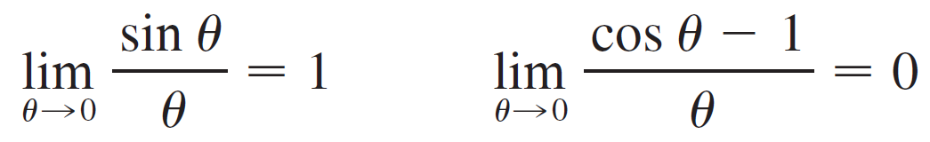


The Sine and Cosine Functions
Consider the following two limits:
By using the above two limits we have:

Slide 40
PROOF
If f(x) = sinx, then

Slide 41
THE SINE AND COSINE FUNCTIONS
Using the same methods as in the proof of Formula 4, one can prove (see Exercise 56) that

Slide 42
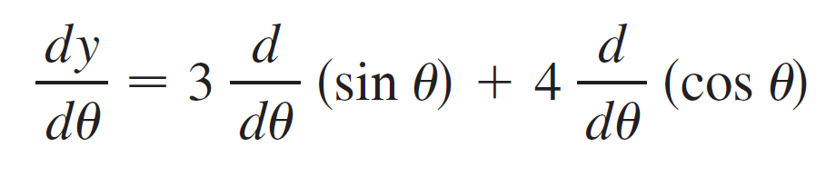

Example 7
Differentiate: y = 3 sin θ + 4 cos θ.
Solution:

Slide 43
Example 8
Find the 27th derivative of cos x.
SOLUTION
The first few derivatives of f(x) = cos x are as follows:

Slide 44
Example 8 SOLUTION
We see that the successive derivatives occur in a cycle of length 4 and, in particular, f ^{(n)}(x) = cos x whenever n is a multiple of 4.
Therefore, f ⁽²⁴⁾(x) = cos x
Differentiating three more times, we have: f ⁽²⁷⁾(x) = sin x

Slide 45
APPLICATIONS TO RATES OF CHANGE
We discussed velocity and other rates of change in Section 2.1, but now that we know some differentiation formulas we can solve problems involving rates of change more easily.

Slide 46
Example 9
The position of a particle is given by the equation where is measured in seconds and in meters.
(a)Find the velocity at time t.
(b)What is the velocity after 2 s? After 4 s?
(c)When is the particle at rest?
(d)When is the particle moving forward (that is, in the positive direction)?

Slide 47
Example 9
(e)Draw a diagram to represent the motion of the particle.
(f)Find the total distance traveled by the particle during the first five seconds.
(g)Find the acceleration at time t and after 4 s.
(h)Graph the position, velocity, and acceleration functions for .
(i)When is the particle speeding up? When is it slowing down?

Slide 48
Example 9(a) SOLUTION
The velocity function is the derivative of the position function. s = f(t) = t ³ – 6t ² + 9t v(t) = ds/dt = 3t ² – 12t + 9

Slide 49
Example 9(b) SOLUTION
The velocity after 2 s means the instantaneous velocity when t = 2, that is,
The velocity after 4 s is:

Slide 50
Example 9(c) SOLUTION
The particle is at rest when v(t) = 0, that is, 3t² – 12t + 9 = 3(t² – 4t + 3) = 3(t – 1)(t – 3) = 0
This is true when t = 1 or t = 3.
Thus, the particle is at rest after 1 s and after 3 s.

Slide 51
Example 9(d) SOLUTION
The particle moves in the positive direction when v(t) > 0, that is, 3t² – 12t + 9 = 3(t – 1)(t – 3) > 0
This inequality is true when both factors are positive (t > 3) or when both factors are negative (t < 1).
Thus the particle moves in the positive direction in the time intervals t < 1 and t > 3.
It moves backward (in the negative direction) when 1 < t < 3.

Slide 52
Example 9(e) SOLUTION
Using the information from (d), we make a schematic sketch of the motion of the particle back and forth along a line (the s-axis).

Slide 53
Example 9(f) SOLUTION
Due to what we learned in (d) and (e), we need to calculate the distances traveled during the time intervals [0, 1], [1, 3], and [3, 5] separately.
The distance traveled in the first second is:
|f(1) – f(0)| = |4 – 0| = 4 m
From t = 1 to t = 3, it is:
|f(3) – f(1)| = |0 – 4| = 4 m
From t = 3 to t = 5, it is:
|f(5) – f(3)| = |20 – 0| = 20 m
The total distance is 4 + 4 + 20 = 28 m

Slide 54
Example 9(g) SOLUTION
The acceleration is the derivative of the velocity function:

Slide 55
Example 9(h) SOLUTION
The figure shows the graphs of s, v, and a.

Slide 56
Example 9(i) SOLUTION
The particle speeds up when the velocity is positive and increasing (v and a are both positive) and when the velocity is negative and decreasing (v and a are both negative).
In other words, the particle speeds up when the velocity and acceleration have the same sign.
The particle is pushed in the same direction it is moving.

Slide 57
Example 9(i) SOLUTION
From the figure, we see that this happens when 1 < t < 2 and when t > 3.
The particle slows down when v and a have opposite signs, that is, when 0 ≤ t < 1 and when 2 < t < 3.

Slide 58
Example 9 SOLUTION
This figure summarizes the motion of the particle.

Slide 59
Applications to Rates of Change

Slide 60
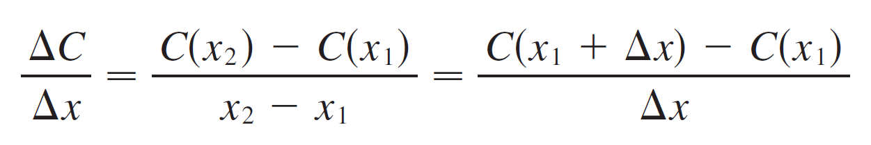
Example 10
Suppose C(x) is the total cost that a company incurs in producing x units of a certain commodity.
The function C is called a cost function.
If the number of items produced is increased from x₁ to x₂, then the additional cost is ΔC = C(x₂) – (x₁), and the average rate of change of the cost is

Slide 61
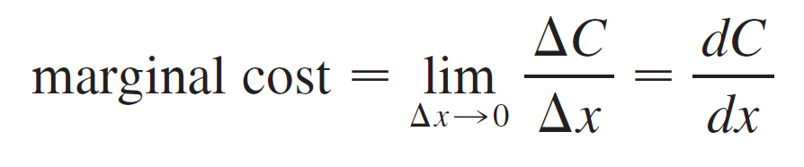
Example 10
cont’d
The limit of this quantity as Δx → 0, that is, the instantaneous rate of change of cost with respect to the number of items produced, is called the marginal cost by economists:
[Since x often takes on only integer values, it may not make literal sense to let Δx approach 0, but we can always replace C(x) by a smooth approximating function.]

Slide 62
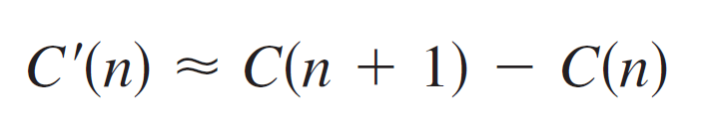
Example 10
cont’d
Taking Δx = 1 and n large (so that Δx is small compared to n), we have
Thus the marginal cost of producing n units is approximately equal to the cost of producing one more unit [the (n + 1)st unit].

Slide 63
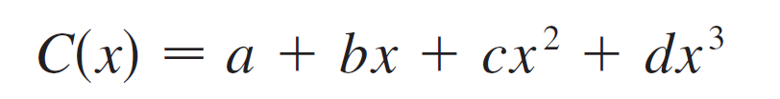
Example 10
cont’d
It is often appropriate to represent a total cost function by a polynomial
Where a represents the overhead cost (rent, heat, maintenance) and the other terms represent the cost of raw materials, labor, and so on. (The cost of raw materials may be proportional to x, but labor costs might depend partly on higher powers of x because of overtime costs and inefficiencies involved in large-scale operations.)

Slide 64
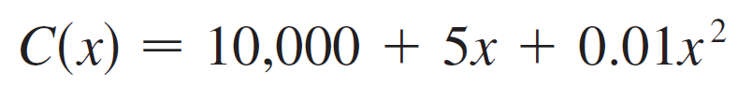


Example 10
cont’d
For instance, suppose a company has estimated that the cost (in dollars) of producing x items is
Then the marginal cost function is
The marginal cost at the production level of 500 items is

Slide 65


Example 10
cont’d
This gives the rate at which costs are increasing with respect to the production level when x = 500 and predicts the cost of the 501st item.
The actual cost of producing the 501st item is
Notice that

